Slide 1

Outline of Study
Chapter 5 : Programming to access DB
How to build a program to access a DB ?
Programming Language (VC/VB/Java/PB etc.)
Programming method
VC within SQL?
DB
DBMS
SQL并发访问DB
VC与SQL通信
Embedded SQL

Slide 2
Database Principles,
Programming and Performance
Chapter 5
Programming to access a Database
5.1 Introduction to Embedded SQL in C
5.2 Common Embedded SQL Statements
5.3 Condition handling
5.4 Programming for Transactions
5.5 Procedural SQL Programs
Embedded SQL
VC与SQL通信
SQL并发访问DB

Slide 3
SQL的局限性
WHY？

Slide 4
突破SQL局限性
1.利用高级语言的表达能力:嵌入式SQL
2.扩展SQL语言对于过程控制的表达能力:过程化SQL
3.在一个更大的视野上，将数据库看做是一-类数据源: ODBC编程

Slide 5
5.1 Introduction to Embedded SQL in C
How to Access the Data in DB by program?
1. SQL ：两种用法“终端交互式、嵌入式” (SQL 语法近似，细节有差异)
2. 嵌入式 SQL：将 SQL 语言嵌入到某种高级语言中，实现对DB的操作。
主语言(宿主语言)属于面向过程的语言，实现程序的流程控制。
嵌入式 SQL 的一般形式：
1）加前缀： EXEC SQL <SQL 语句> LT嵌入式前缀
2）结束标志，随主语言语句的不同而不同
3）嵌入式 SQL 句分两类: Declaration Statement /说明性语句
Executable Statement /可执行语句(DDL, DML, DCL)
exec sql begin declare section;
char c_id[5] = "c001", c_name[14];
int c_discnt;
exec sql end declare section;
exec sql select cname, discnt into :c_name, :c_discnt from customers where cid = :c_id;
……
Notes:
s

Slide 6
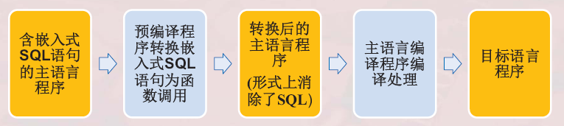
嵌入式SQL的处理过程

Slide 7
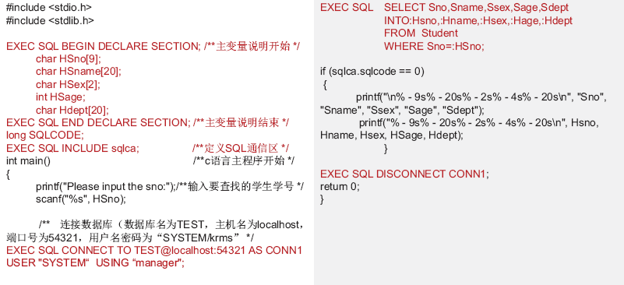

Slide 8



Slide 9
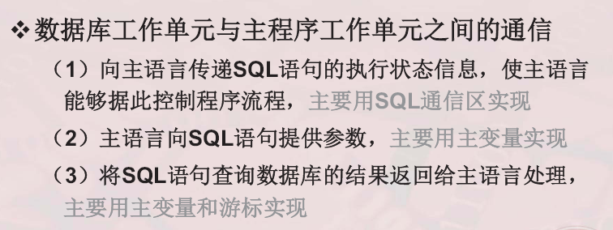
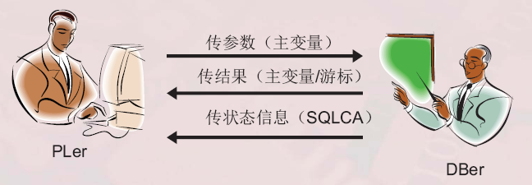

Slide 10
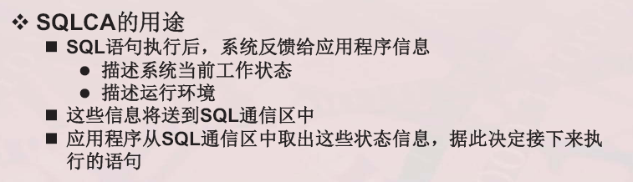
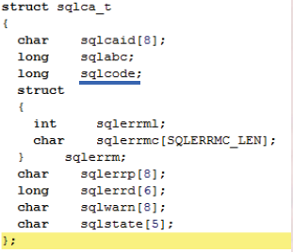
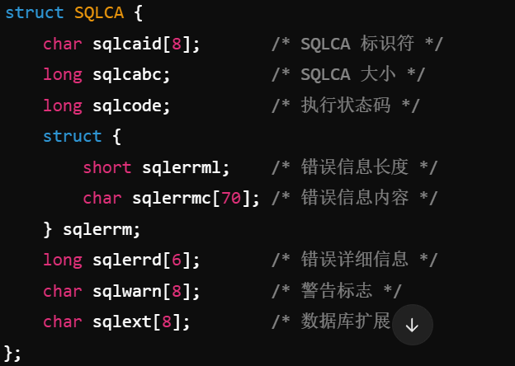

Slide 11
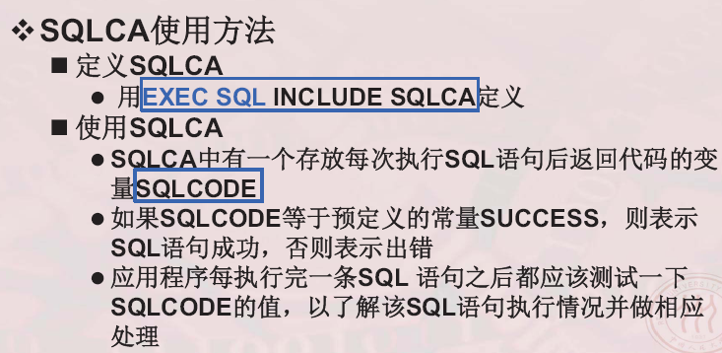

Slide 12
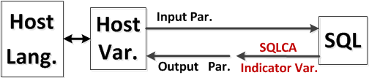
5.1 Introduction to Embedded SQL in C
Cursor
3. A Simple Program
exec sql begin declare section;
char c_id[5] = "c001", c_name[14];
float c_discnt; LT定义主变量
exec sql end declare section;
c_id = “c005”; LTC语言区域
exec sql select cname, discnt into :c_name, :c_discnt from customers where cid = :c_id;
printf("Customer name is %s, discount is %f\n", c_name, c_discnt);
[1] Signal of Embedded SQL statement : exec sql
对嵌入式 SQL句，DBMS 采用两种方式编译：
①预编译（Pre-compiler 目前使用较多。See the Appendix B, p737）
②修改和扩充主语言的Compiler，使之能处理 SQL
DB
Notes:
s

Slide 13
5.1 Introduction to Embedded SQL in C
[2] Host Variable
Must be declared by a SQL declare section LT声明要加这个
Used in Embedded SQL statement, with form in “:c_id”加冒号
Used in Host language, with form in “c_id”主变量在C中不加：
[3] Note: can’t use character-string to contain part of statement
Eg: Below form is ill-legal, want to use "Dynamic SQL".
不能这么做LT
char cond[ ] = " cid = 'c003' and city = 'Boston' ";
exec sql select cname into :custname
from customers where :cond;
Notes:
s

Slide 14
5.1 Introduction to Embedded SQL in C
[4] SQL CONNECT and DISCONNECT to DBMS LT连接和断连
Connect (1) exec sql CONNECT TO target_Dbname LT库名
LT账密 [AS connect_name] [USER username];
定义变量时不连接省空间(2) exec sql CONNECT TO DEFAULT;LT缺省方式
Disconnect (1) exec sql DISCONNECT connect_name; LT切换时断开
(2) exec sql DISCONNECT current;即用即连，增加并发
[5] COMMIT and ROLLBACK statementLT查到一个集合与单一变量不对等
Using COMMIT statement to successful complete the data to Database, before the Disconnect statement LT缓存写入磁盘
Using ROLLBACK statement to undo any work in an unsuccessful task, before the Disconnect statement LT不写入
此二者都结束了事务，前者访问成功；后者失败回滚，无事发生
Notes:
s

Slide 15
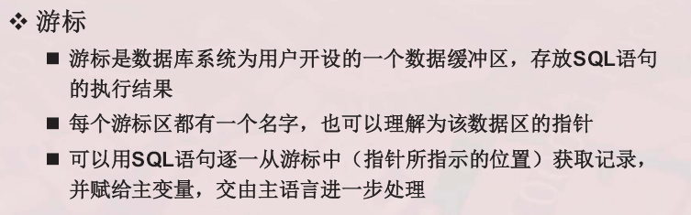


Slide 16
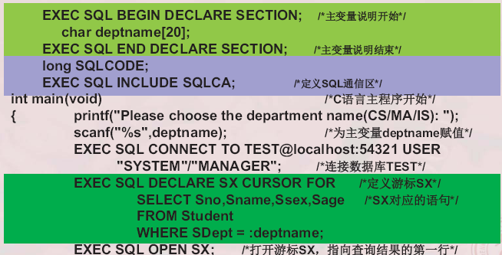

Slide 17
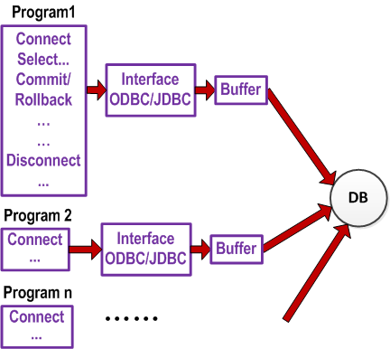
5.1 Introduction to Embedded SQL in C
为什么要使用游标？
LT除了JAVA的可用ODBC,JAVA用JDBC
Notes:
s

Slide 18

5.1 Introduction to Embedded SQL in C
1) Connect is a Source
2) Using:
CONNECT
SQL句
commit / rollback
DISCONNECT
控制面板/管理工具/数据源(ODBC)/ODBC数据源管理器

Slide 19
5.1 Introduction to Embedded SQL in C
[6] Example 5.1.1 the program prompts a user repeately input a cid and replies by printing its cname and discount, halting when user input an empty string
#include <stdio.h> /*Header for prompted-input function*/
#include “prompt.h” /*Head of DBS’s SQLCA structure*/
exec sql include sqlca;
char cid_prompt[]=“ Please input customer id: ”;
int main()
{ exec sql begin declare section;
char cust_id[5],cust_name[14],user_name[20],user_pwd[20];LT访问数据库的用户帐密，要查询的信息
float cust_discnt;
exec sql end declare section;
Notes:
s

Slide 20
5.1 Introduction to Embedded SQL in C
exec sql whenever sqlerror goto report-error; /*error condition*/
LT如果sqleeror成立就跳转到repoter-error
exec sql whenever not found goto not-found; /*not found condition*/
strcpy(user_name, "Scott");
strcpy(user_pwd, "Tiger");
exec sql connect :user_name to CAP identified by :user_pwd; /*Oracle’s connect*/
while (prompt(cid_prompt,1,cust_id,4))>0) /*Get input of “cust_id”, is it empty?*/
{ exec sql select cname, discnt into :cust_name, :cust_discnt
from customers where cid = :cust_id;
exec sql commit work ;LT放开数据库 /*Transaction end & release read lock*/
if sqlca.sqlcode=0 then printf ("Customer name is %s,
discount is %5.1f\n", cust_name, cust_discnt);
continue;
not-found : printf(“Can’t find customer %s”, cust_id);
} /* end of while*/
Notes:
s

Slide 21



5.1 Introduction to Embedded SQL in C
exec sql commit release; /*Oracle’s disconnect*/oracle没有disconect
/*use: exec sql commit work; or exec sql disconnect current;*/
return 0; /*Indicate success of program*/
report-error : print_dberror(); /*Print out error message*/
exec sql rollback release; /*Oracle’s disconnect from DB in error*/
return 1; /*Indicate failure of program*/
}
[7] Character & String in DBMS and in C
char(5) in C, always contain ‘\0’ as end flag.
in DB，分 两种类型 char(5) and varchar(5)
故: 嵌入了 SQL 的 C 程序里，两种语言之间字符赋值，可能有变数
[8] function: Prompt , Print_dberror （See Appendix B, p.735）
Notes:
s

Slide 22
5.1 Introduction to Embedded SQL in C
How to use the Data by program?
2. process Multiple Rows in SQL VS. One row in C
Relationship between Host-Language and SQL
Cursor
DB
向主语言传递 SQL 的执行状态，用 SQL Communication Area (SQLCA) 或Indicator Variable
主语言向 SQL 提供参数用Host Variable；
SQL将 对DB 的处理结果(集合) 交给 主语言时，用 Host Variable 和 Cursor
Notes:
s

Slide 23
5.1 Introduction to Embedded SQL in C
2. process Multiple Rows in SQL VS. One row in C
[1] SQLCA：“结构类型”的系统变量， ORACLE 中定义为
struct sqlca { char sqlcacaid[8];
long sqlcabc;
long sqlcode; /* state value of sql process */
struct sqlerrm {unsigned short sqlerrml; char sqlerrmc[70];}; /*error codes of sql*/
char sqlerrp[8];
long sqlerrd[6]; /* rows number of sql process*/
char sqlwarn[8];
char sqlext[8]; };
使用前，先在主程序中声明SQL通信区标识符：
exec sql include sqlca; (sqlca 属DBMS已定义、默认的系统结构变量名)
要操作多个DB时，可声明新的SQL通信区标识符：LT系统中有多个数据库
struct sqlca sqlcb; (用sqlca 说明同结构的其它“通讯区标识”)
exec sql include sqlcb;LT复制一份SQLCA至SQLCB
Notes:
s

Slide 24
5.1 Introduction to Embedded SQL in C
SQLCA结构中的常用域：
(1)Sqlca.sqlcode, 存放当前 SQL 句执行后的状况，有三种可能值：
=0: 代表Success，即sql 句执行成功，说明buffer中有数据可用
>0: 代表not found ，即sql 句执行成功，但结果为 null
<0: 代表sqlwarning或error，程序或系统故障，错误码含义见子域sqlca.sqlerrm.
(2)Sqlca.sqlerrd[2]，当前 DML 语句执行后，处理的数据行数。
Note: DBMS产品不同 Sqlca.sqlcode 的取值和意义会有差异。
[2] Getting Error Messages from the Database
查DBMS 产品的sqlca结构，找反映 SQL 执行状态的域名；关注其取值
找sqlca中表示“error”的 code & meaning的域。在SQL后检测执行状态值，作相应处理。
ORACLE 中 sqlca.sqlerrm 返回有DB的 Error Massage；或调用 ORACLE 的函数 Print_dberror()可给出 Error Massage。
Notes:
s

Slide 25
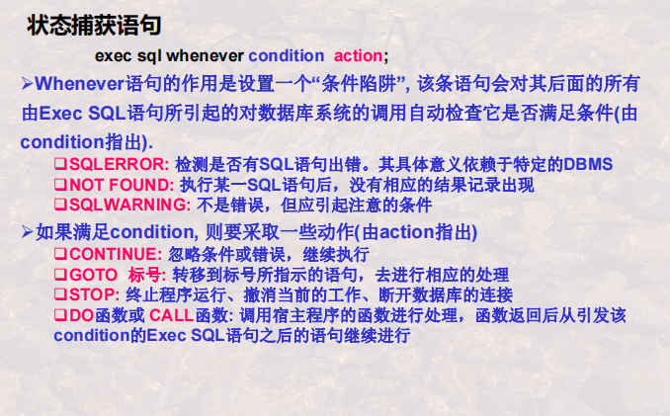

Slide 26
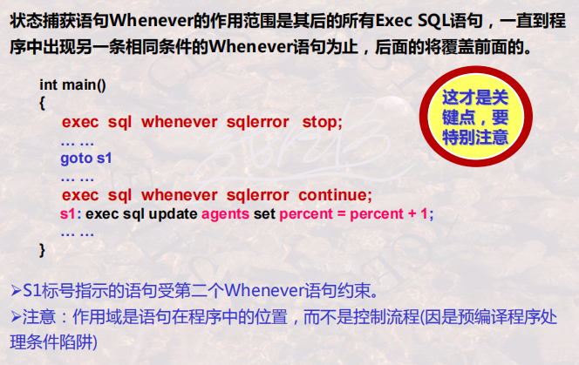

Slide 27
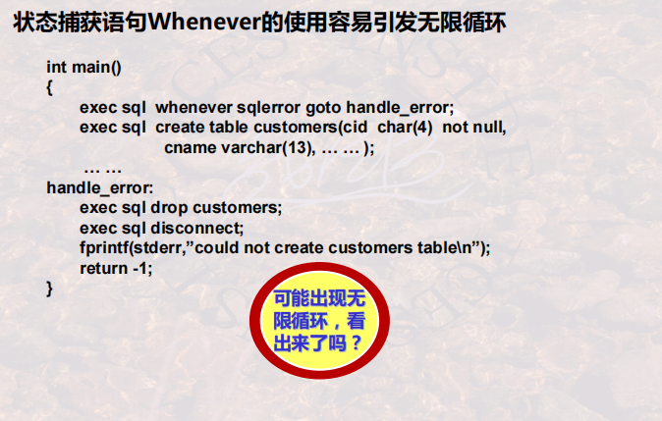

Slide 28
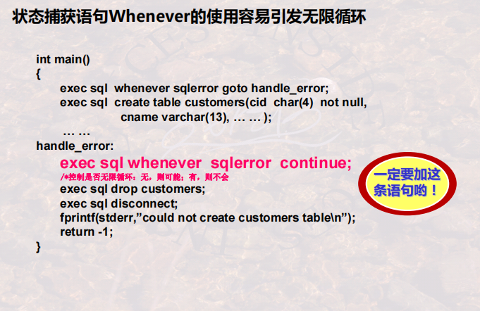

Slide 29
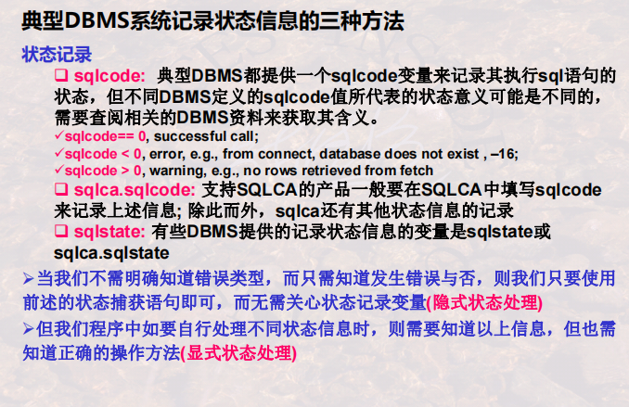

Slide 30
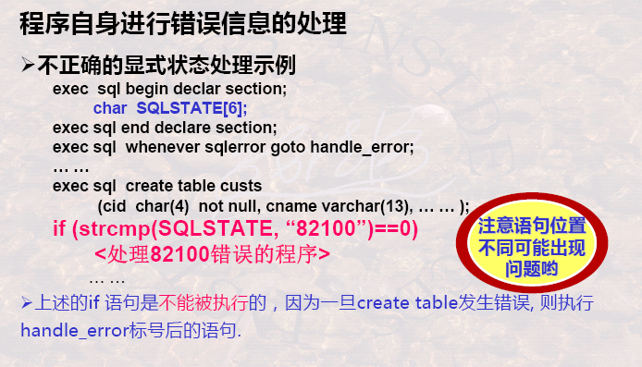

Slide 31
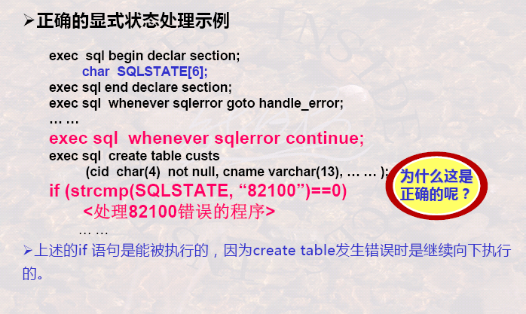

Slide 32
5.1 Introduction to Embedded SQL in C
[3] Host variable (主变量)
① Definition in Host Language，there are Three Types of Host vars.
Input host variable： 由主语言对其赋值，在 SQL 句中引用。
Output host variable：由 SQL 语句对其赋值，在主语言中引用。
Indicator variable (指示变量)：整型，跟在(I/O) Host Var之后，用于“指示”
主变量值的可用性。
②说明： exec sql begin declare section;
char cust_id; c_dis;
exec sql end declare section;
③主变量、指示变量用法：
在SQL句中以冒号(:)为标志，且指示变量应跟在主变量之后。当它们所在 SQL句执行后，由此Indicator-Var的值 确定前面host-Var之值的合法性、可用性.
在主语言中使用，不必加冒号。
Notes:
s

Slide 33
5.1 Introduction to Embedded SQL in C
④Eg：exec sql begin declare section
char cust_id, c_dis;
integer c_ind;
exec sql end declare section
cust_id=‘c002’;
exec sql select discnt into :c_dis :c_ind from customers
where cid=:cust_id;
if (c_ind==0) printf(“The discount of %s is %d !\n”, cust_id, c_dis);
……
⑤ Indicator var 跟在某个Host-Varible之后，指示 SQL执行后，此Host-Var值的合法性。故Indicator-Var 值也有三种可能。在Oracle中为：
= 0， not null, the value is assigned to the host-varible.
> 0， a truncated value is assigned to the host-varible.
= -1，is null, the host-varible value is not a meaningful.
Output Host-var
Indicator var
Input Host-var
Notes:
s

Slide 34
5.1 Introduction to Embedded SQL in C
[4] Cursor(游标)
①Cursor：DBMS为用户开设的Data buffer，存放 SQL 的执行结果集，buffer中有一默认指针，供用户逐一访问 Data Record。
②Function：
③Using Method：four steps
a)定义游标 (declare cursor)
b)打开游标 (open cursor)LT执行语句
循环体中 → c)推进游标 (fetch cursor)，并将当前指向的buffer数据, 放入主变量中
LT同时指针跳到下一个的位置
d)关闭游标 (close cursor)
Notes:
s

Slide 35
5.2 Common Embedded SQL statements
1. Declare Cursor
exec sql declare <cursor_name> cursor for <Subquery>
LT是否只读 [Read only | For update of colname];
Notice:
FOR UPDATE OF: promising to Update/Delete rows through cursor
READ ONLY: not promising to …… through cursor
2. Cursor Open, Fetch and Close
[1] Cursor open: exec sql OPEN <cursor_name>;
[2] Cursor fetch: exec sql FETCH <cursor_name> INTO <host_v1>{,<host_v2>...};
[3] Cursor close: exec sql CLOSE < cursor_name >;
Notes:
s

Slide 36


Slide 37
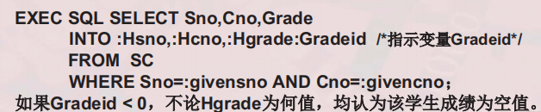
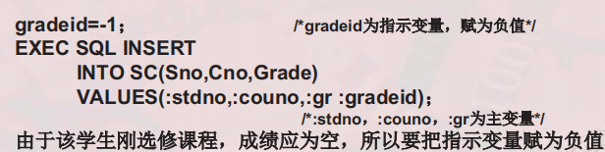

Slide 38
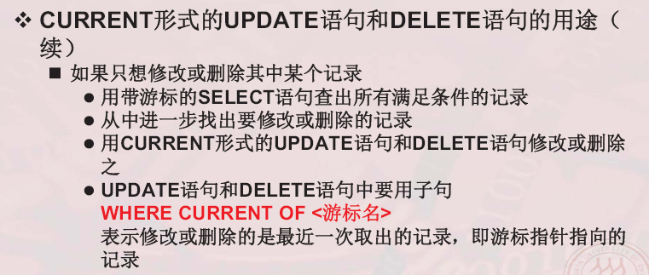

Slide 39
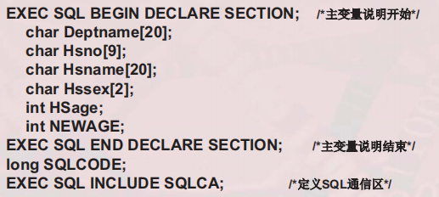
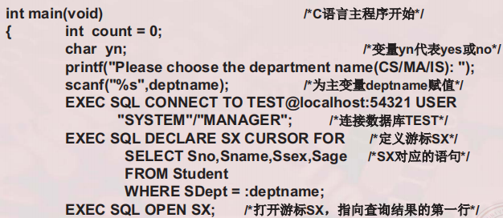

Slide 40
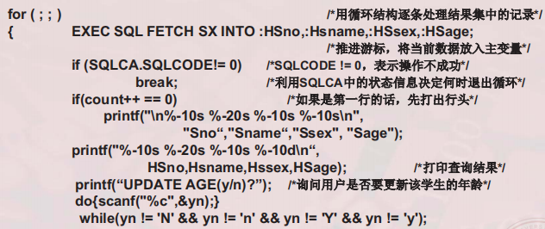
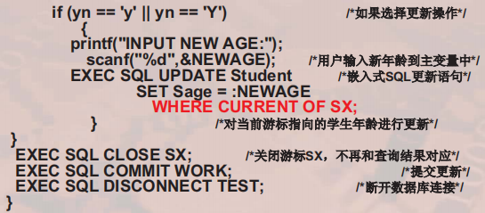

Slide 41


Slide 42
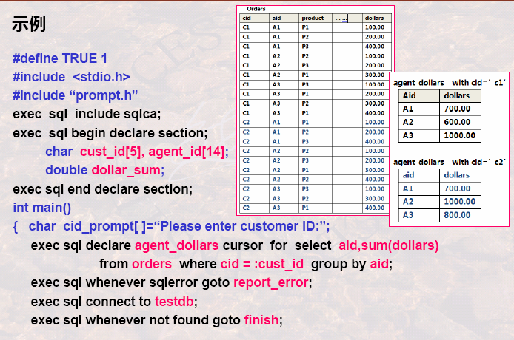

Slide 43
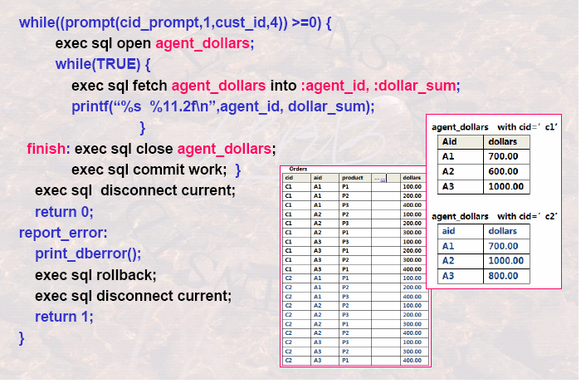

Slide 44
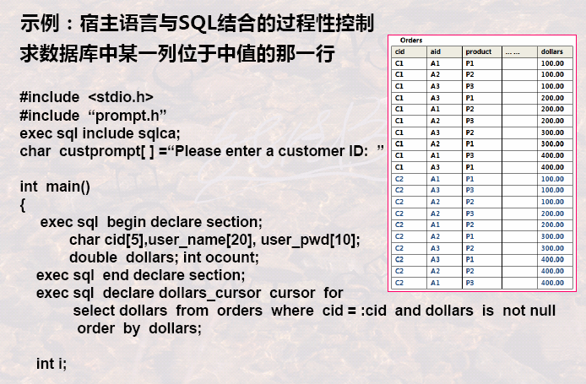

Slide 45
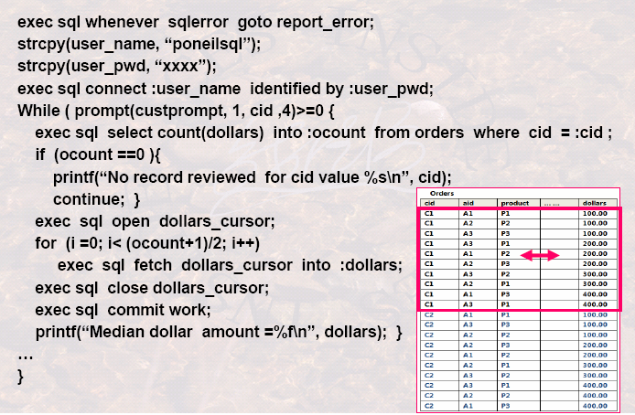

Slide 46

填空题
3分
5. C语言和嵌入式SQL语言联合编制的数据库访问程序中，两种语言之间可使用 [填空1] 或 [填空2] 传递参数。
使用 [填空3] 传递嵌入式SQL访问数据库之后的状态信息。
6. C语言和嵌入式SQL语言联合编制的数据库访问程序中，用SQLCA结构变量传递SQL访问数据库后的状态，其中SQLCA.sqlcode的可能状态有 [填空1] 种 ，分别表示 [填空2] 、 [填空3]、 [填空4]
正常使用填空题需3.0以上版本雨课堂
作答

Slide 47
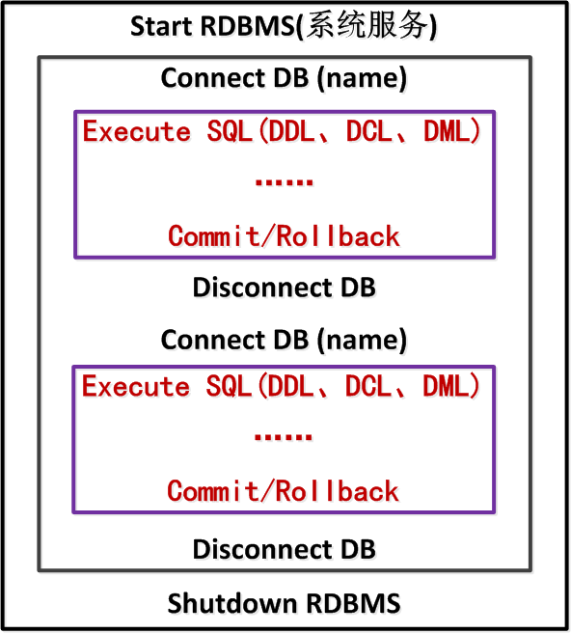
5.2 补充
[6] The Frame for
using SQL:
RDBMS用户并发数有限
应避免长期占用
Notes:
s

Slide 48
5.2 Common Embedded SQL statements
3. Embedded Select
[1] Basic Embedded Select Form
EXEC SQL SELECT [ALL|DISTINCT] expression{, expr…}
INTO host_variable { , host_variable… }
FROM tableref [corr_name] {, tableref[corr_name] …}
[WHERE search_condition ]
NOTE:
Only a single row can be retrieved by an Embedded Select , so the GROUP BY, HAVING, UNION, and ORDER BY clauses are not included in the form.
If A Select statement can be executed in a program without use of a cursor, only when no more than one row is to be retrieved (zero/one row is permitted).
Notes:
s

Slide 49
5.2 Common Embedded SQL statements
[2] Example1：已知学生信息表 Students(sno, sname, ssex, sage, sdepartment).
编程查询某系全体学生的信息，系名由用户在程序运行时输入。
#define TRUE 1
#include <stdio.h>
#include “prompt.h”
exec sql include sqlca;
exec sql begin declare section;
char hdept[10], hsno[4], hname[10], hsex[2];
int hage;
exec sql end declare section;
Notes:
s

Slide 50
5.2 Common Embedded SQL statements
int main()
{char msg[]=” Please input the department name: ”;
exec sql declare c_student cursor for
select sno, sname, ssex, sage, sdepartment from students
where sdepartment = :hdept read only;
exec sql whenever sqlerror goto report-error; /*error condition */
exec sql whenever not found goto finish; /* not found condition */
while (prompt(msg,1, hdept,10))>0) { /* input hdept name */
exec sql connect to testdb;
exec open c_student;
while (TRUE) { exec sql fetch c_student into :hsno, :hname, :hsex, :hage;
if (sqlca.sqlcode==success)
printf("%s %s %s %d\n", hsno, hname, hsex, hage);
else break; } /* End of nest While */
……
Notes:
s

Slide 51
5.2 Common Embedded SQL statements
finish: exec sql close c_student ;
exec sql commit work; } /* End of While */
exec sql disconnect current ; /* Disconnect from database */
return 0; /* Indicate success of program */
report-error : print_dberror(); /* Print out error message */
exec sql rollback work ;
exec sql disconnect current ;
return 1; /* Indicate failure of program */
}
Notes:
s

Slide 52
5.2 Common Embedded SQL statements
4. Embedded Delete
[1] Two forms of Delete statement
● Searched Delete ● Positioned Delete
[2] Embedded Delete statement
exec sql DELETE FROM tablename [corr_name]
[WHERE search_condition | WHERE CURRENT OF cursor_name];
Notes: in Searched Delete, sqlca.sqlcode and sqca.sqlerrd[2] contains information on
To determine number of rows be processed.
Not found, when return no rows.
Error, when an executed error is occurred.
Notes:
s

Slide 53
5.2 Common Embedded SQL statements
[3] Example 5.3.1 Delete all customers from the customers table who live in Duluth and have made no orders.
a) In a Searched Delete
exec sql delete from customers c where c.city = ‘Duluth’ and
not exists (select * from orders o where o.cid =c.cid) ;
b) In a Positioned Delete: Declare a cursor to delete current row.
exec sql declare delcust cursor for
select cid from customers c where c.city = ‘Duluth’ and not exists
(select * from orders o where o.cid = c.cid) for update of cid;
exec sql whenever not found goto skip;
exec sql open delcust;
while (TRUE) {exec sql fetch delcust into :cust_id;
exec sql delete from customers where current of delcust;}
skip : ……
Notes:
s

Slide 54
5.2 Common Embedded SQL statements
5. Embedded Update
[1] Two forms of Update statement
● Searched Update ● Positioned Update --- using a cursor
[2] Forms of Embedded Searched Update statement
exec sql UPDATE tablename [corr_name]
SET colname1 = expr { , colname2 = expr… }[WHERE search_condition];
[Notes] In Searched Update, sqlca.sqlcode and sqlca.sqlerrd[2] contains information:
To determine number of rows be updated.
Not found, when return no rows.
Error, when an executed error is occurred.
Notes:
s

Slide 55
5.2 Common Embedded SQL statements
[3] Forms of Embedded Positioned Update statement
exec sql UPDATE tablename SET columnname=expr { , column=expr… }
WHERE CURRENT OF cursor_name ;
[4] Example 2：已知 students表，编程查询某系全体学生的信息，系名由用户在程序运行时输入，根据用户要求修改其中某些学生的年龄。
#define TRUE 1
#include <stdio.h>
#include “prompt.h”
exec sql include sqlca;
exec sql begin declare section;
char hdept[10], hsno[4], hname[10], hsex[2];
int hage;
exec sql end declare section;
Notes:
s

Slide 56
5.2 Common Embedded SQL statements
int main()
{char msg[]=”Please input the department name: ”;
exec sql declare p_student cursor for
select sno, sname, ssex, sage, sdepartment from students
where sdepartment = :hdept for update of sage;
exec sql whenever sqlerror goto report_error; /*error condition*/
exec sql whenever not found goto finish; /* not found condition */
while (prompt(msg,1, hdept,10)) > 0) { /* input hdept name */
exec sql connect to testdb;
exec sql open p_student;
while (TRUE) {exec sql fetch p_studen into :hsno, :hname, :hsex, :hage ;
if (sqlca.sqlcode == success)
{ printf("%s %s %s %d\n", hsno, hname, hsex, hage);
printf(“ Update the age of this record ? ”);
scanf(“%c”, ans);
Notes:
s

Slide 57
5.2 Common Embedded SQL statements
if (ans == ’y’) { printf(“ Input the new age : ”); scanf(“%d”, hage);
exec sql update student set sage = :hage where current of p_student;}}
else break; /* end of while (TRUE) */
……
finish: exec sql close p_student ;
exec sql commit work; } /* end of while (prompt) */
exec sql disconnect current ; /* Disconnect from database */
return 0;
report_error : print_dberror(); /* Print out error message */
exec sql rollback work ;
exec sql disconnect current ;
return 1;
}
Notes:
s

Slide 58
5.2 Common Embedded SQL statements
6. Embedded Insert: (only has a single form)
exec sql INSERT INTO tablename [ (columnname { , columnname…} ) ]
{VALUES (expr { , expr } ) | Subquery } ;
In Insert Statement, sqlca.sqlcode and sqlca.sqlerrd[2] contains information:
Success, to determine number of rows be processed.
Not found, If no rows insert.
Error, when an executed error is occurred.
7. Other Embedded SQLs
[1] They are: exec sql create table, exec sql drop table,
exec sql alter table, exec sql create view etc.
[2] All of other Embedded SQL Statement, see in Appendix C.
Notes:
s

Slide 59
5.3 Condition Handling
1.Whenever Statement
exec sql WHENEVER condition action ;
[1]Function: whenever allow us to control execution in face of errors & condition
exec sql whenever sqlerror goto report_error ;
Note: “sqlerror” is a condition, “goto report_error” is an action.
[2]Condition:
SQLERROR: Tests for errors following each EXEC SQL.
Eg: in ORACLE, “-02019: database link dose not exist.”
NOT FOUND: Tests when no rows are affected following
EXEC SQL… such as Fetch, Update, or Delete.
SQLWARNING: This is defined as an extended feature of SQL_99.
Notes:
s

Slide 60
5.3 Condition Handling
[3] Action ● CONTINUE
● GOTO label
● STOP
● DO function
[4]Example 5.2.1:(P274) Find the errors in following statement fragment.
Main()
{ exec sql whenever sqlerror stop; /* First whenever statement*/
……
goto s1;
……
exec sql whenever sqlerror continue; /*Overrides Fisrt whenever*/
s1: exec sql update agents set percent = percent + 1;
……
……
return -1}
Notes:
s

Slide 61
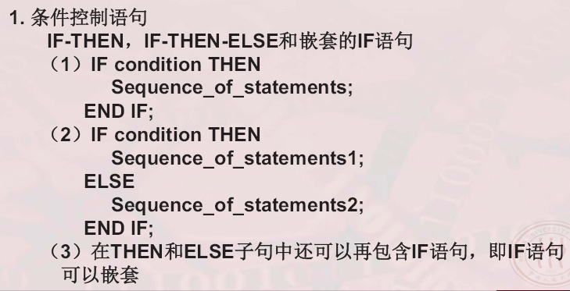

Slide 62
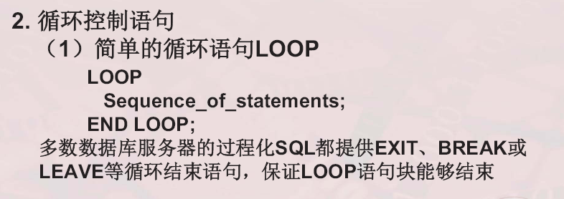

Slide 63
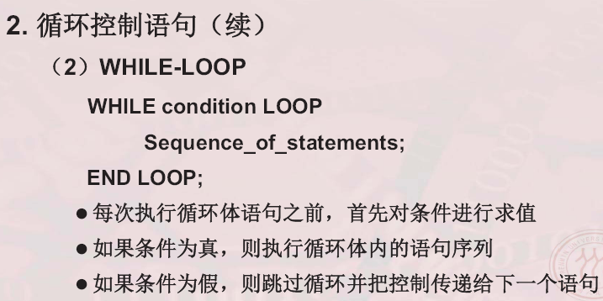

Slide 64
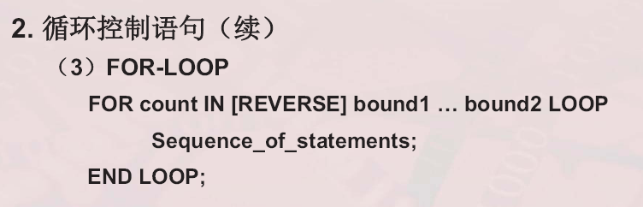

Slide 65
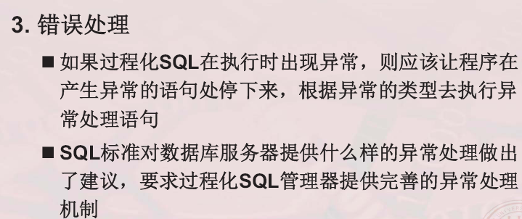

Slide 66
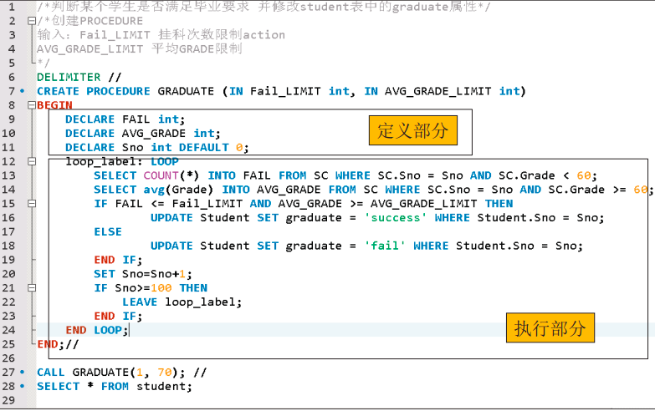

Slide 67
5.3 Condition Handling
[5] Example5.2.2:(P275) Find errors in following sequence statement. Main()
{ exec sql whenever sqlerror goto handle_error; /* First whenever */
exec sql create table customers (cid char(4) not null, cname …) ;
……
handle_error : exec sql whenever sqlerror continue; /*当Create table失败转入*/
exec sql drop table customers; /*Drop表出错，转回First whenever, 死循环*/
exec sql disconnect;
printf (“Could not create customers table\n”);
return –1;
……
}
Notes:
s

Slide 68
5.3 Condition Handling
[6]Example 5.2.3 (P276) Explicating the error processing in ORACLE.
exec sql begin declare section; char sqlstate[5]; /*Store the SQL state*/
exec sql end declare section;
exec sql create table custs (cid char(4) not null, cname varchar(13), …) ;
sqlstate = str(sqlca.sqlcode); /* 检查 SQL 的执行状态,作相应处理 */
if ( strcmp(sqlstate,’82100’ ) == 0 ) /* ORACLE, out of disk space? */
<call procedure to handle this condition>
else if (strcmp(sqlstate,’00000’ ) != 0 ) { /* ORACLE, Another error? */
goto handle_error;
exec sql whenever sqlerror goto handle_error;
…… }
handle_error ：……
Notes:
s

Slide 69
5.3 Condition Handling
4. Checking Error by Indicator Variables
[1] Example 3: Find discount of cid. Assume cid has been input.
Host Vars ------ cust_id; cust_discnt;
S1) exec sql select discnt into :cust_discnt from customers where cid = :cust_id;
S2) exec sql begin declare section;
float cust_discnt; int cd_ind; char cust_id
exec sql end declare section;
exec sql select discnt into :cust_discnt :cd_ind
from customers where cid = :cust_id;
if (cd_ind==0) printf(“The discount of %s is %d ! \n”, cust_id, cust_discnt);
……
Notes:
s

Slide 70
5.3 Condition Handling
[2] Example 4: Update the null discount to the specify cid’s.
Host Vars ------ cust_id, cust_discnt, cd_ind
scanf(“%s”, cust_id);
scanf(“%d”, cust_discnt);
cd_ind = -1;
exec sql update customers
set discnt = :cust_discnt :cd_ind where cid = :cust_id;
Notes:
s

